Slide 1
Chapter 22

Slide 2
Objectives

Slide 3
Data for three products

Slide 4
An XML document that contains the data for the three products

Slide 5
An XML document

Slide 6
Tags, XML declarations, and comments

Slide 7
Elements

Slide 8
An XML document

Slide 9
When to use attributes instead of child elements

Slide 10
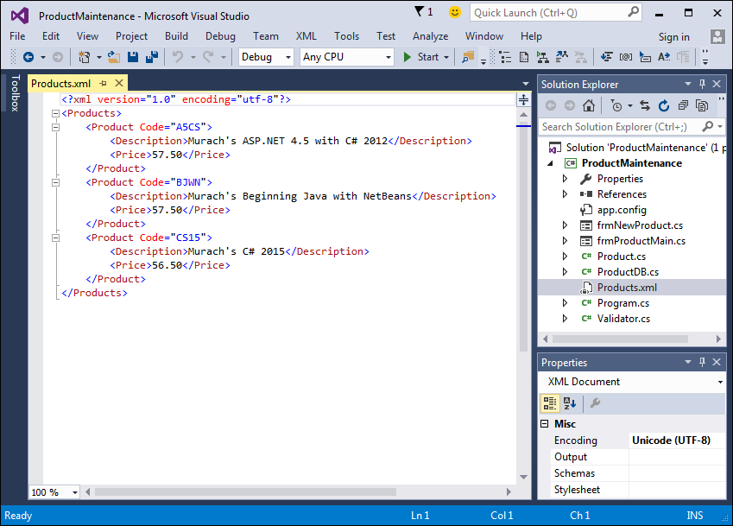
An XML document in the XML Editor

Slide 11
How to add a new XML file to a project

Slide 12
How to edit an XML file

Slide 13
Common methods of the XmlWriter class

Slide 14
Code that writes an XML document

Slide 15
Code that writes an XML document (cont.)

Slide 16
Common indexer of the XmlReader class

Slide 17
Common methods of the XmlReader class

Slide 18
An XML document

Slide 19
The XML nodes in this document

Slide 20
Code that reads an XML document

Slide 21
Code that reads an XML document (cont.)

Slide 22
A class that works with an XML document

Slide 23
A class that works with an XML document (cont.)

Slide 24
A class that works with an XML document (cont.)

Slide 25
A class that works with an XML document (cont.)

